Slide 1
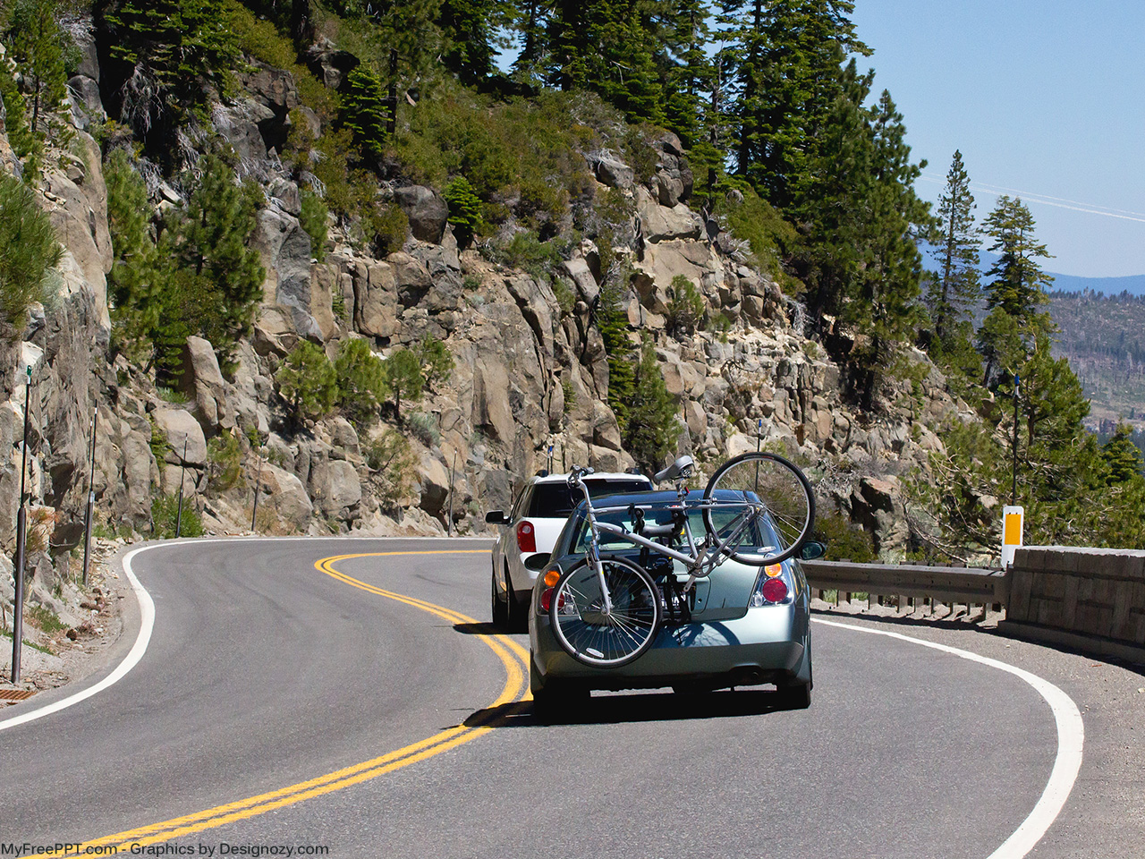
Take your bike on tour

Slide 2
Add Your Title
Phasellus non tellus condimentum, sodales nisl congue, sodales justo.
Donec ac velit sit amet est malesuada imperdiet.
Find More PowerPoint Templates, Backgrounds, Presentations From MyFreePPT.com

